Slide 1

SOFT354: Parallel Computation and distributed systems
Week 5
Dr Robert Merrison-Hort

Slide 2
This week’s lecture
Compute to global memory access (CGMA) ratio for simple and shared memory matrix multiplication.
Quickly look at a couple of common workshop issues.
Convolution:
What is it
Simple 1D convolution kernel
Shared memory 1D convolution kernel
Performance comparison

Slide 3
reminder
Practice test next week: Thursday 3th November.
In the usual lecture slot / room.
Doesn’t count towards your mark (but take it seriously!)
Short sentence / single word / number answers only.
Bring a calculator (though there shouldn’t be anything you can’t work out in your head / on paper).

Slide 4
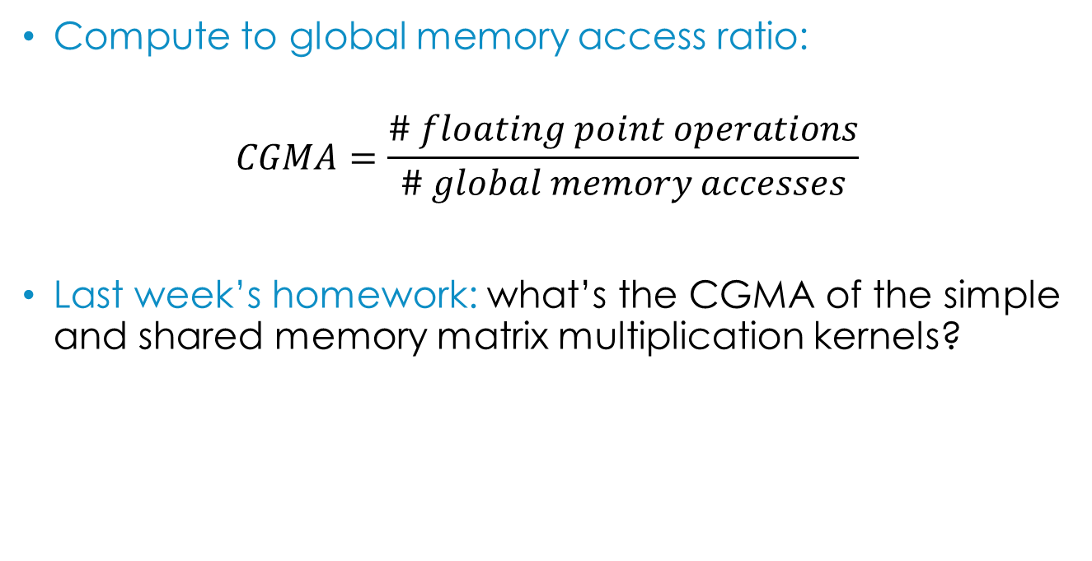
CGMA for matrix multiplication
Compute to global memory access ratio:
$$CGMA=\frac{\# floating point operations}{\# global memory accesses}$$
Last week’s homework: what’s the CGMA of the simple and shared memory matrix multiplication kernels?

Slide 5
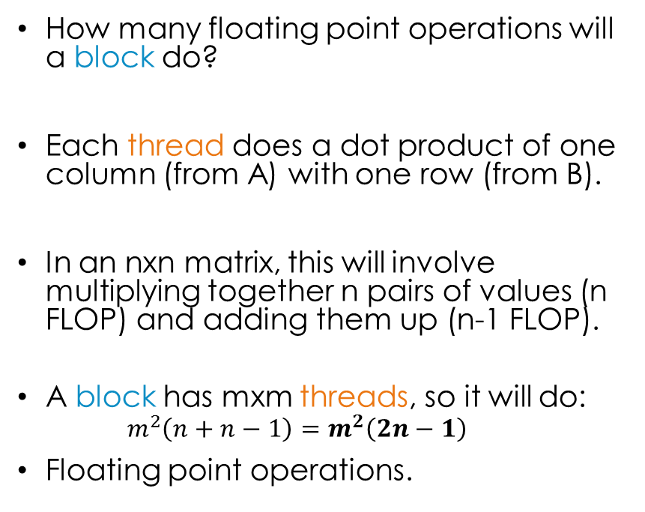
CGMA for matrix multiplication
How many floating point operations will a block do?
Each thread does a dot product of one column (from A) with one row (from B).
In an nxn matrix, this will involve multiplying together n pairs of values (n FLOP) and adding them up (n-1 FLOP).
A block has mxm threads, so it will do:
$$m^{2}\left(n+n−1\right)=m^{2}\left(2n−1\right)$$
Floating point operations.
5 | 6
7 | 8
B
A
1 | 2
3 | 4
? | ?
? | ?

Slide 6
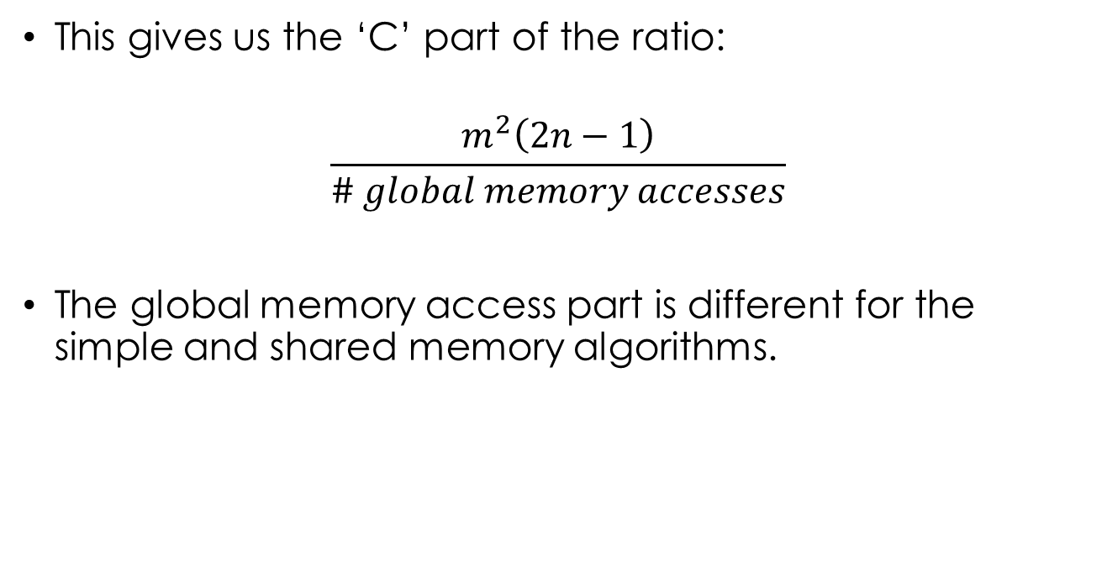
CGMA for matrix multiplication
This gives us the ‘C’ part of the ratio:
$$\frac{m^{2}\left(2n−1\right)}{\# global memory accesses}$$
The global memory access part is different for the simple and shared memory algorithms.

Slide 7
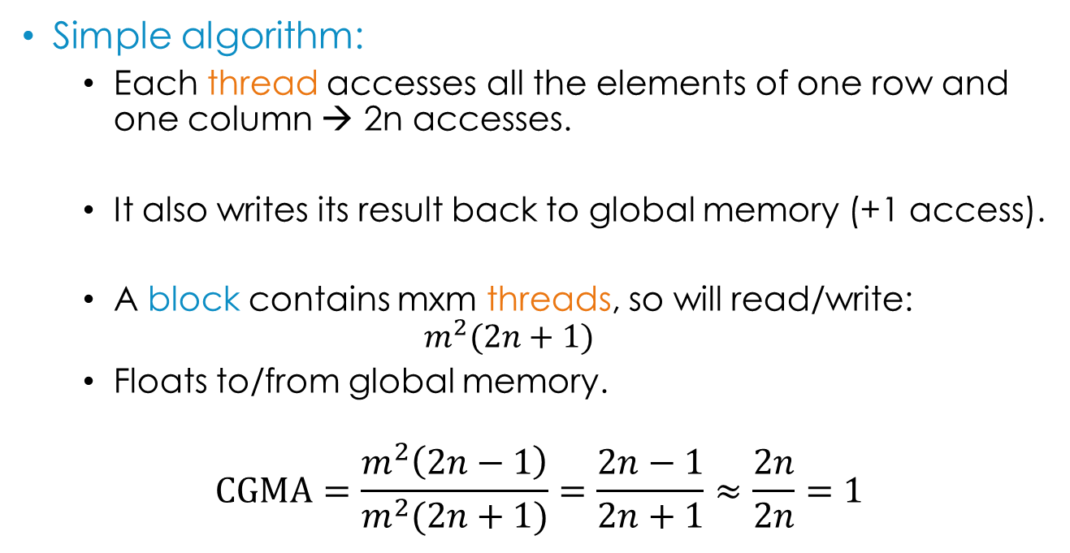

CGMA for matrix multiplication
Simple algorithm:
Each thread accesses all the elements of one row and one column → 2n accesses.
It also writes its result back to global memory (+1 access).
A block contains mxm threads, so will read/write:
$$m^{2}(2n+1)$$
Floats to/from global memory.
$$CGMA=\frac{m^{2}\left(2n−1\right)}{m^{2}(2n+1)}=\frac{2n−1}{2n+1}≈\frac{2n}{2n}=1$$
Rubbish!
$$(m≠0)$$
Notes:
When n is relatively large the -1 and +1 have basically no effect so we can ignore them. For example, if n=100, (2n-1)/(2n+1)=0.99

Slide 8
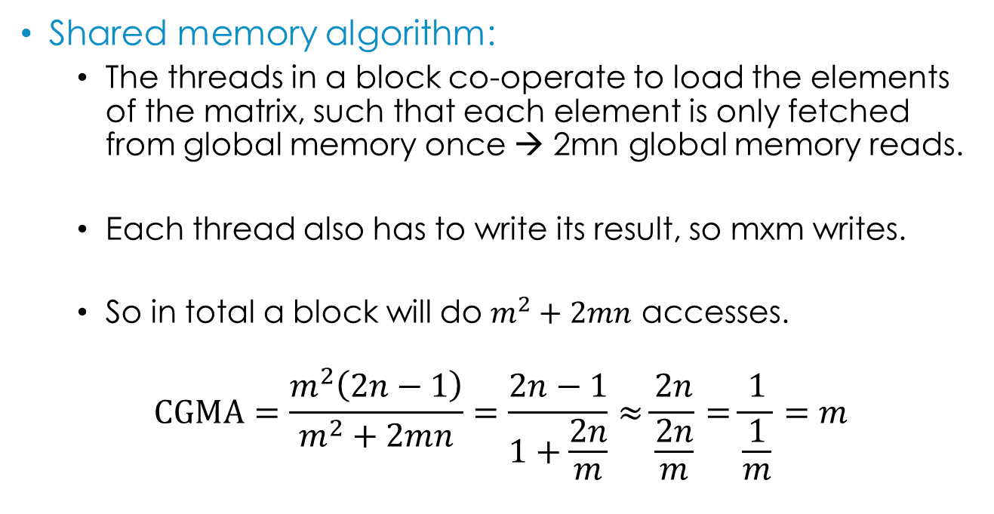
CGMA for matrix multiplication
Shared memory algorithm:
The threads in a block co-operate to load the elements of the matrix, such that each element is only fetched from global memory once → 2mn global memory reads.
Each thread also has to write its result, so mxm writes.
So in total a block will do $m^{2}+2mn$ accesses.
$$CGMA=\frac{m^{2}\left(2n−1\right)}{m^{2}+2mn}=\frac{2n−1}{1+\frac{2n}{m}}≈\frac{2n}{\frac{2n}{m}}=\frac{1}{\frac{1}{m}}=m$$
Notes:
When n is relatively large the -1 and +1 have basically no effect so we can ignore them. For example, if n=100, (2n-1)/(2n+1)=0.99

Slide 9
CGMA for matrix multiplication
For n=1000:
More on CGMA later in the lecture…

Slide 10
Some common workshop problems
The expression sizeof(someVar) is replaced with the size (in bytes) of someVar at compile time.
So if you have a statically allocated array:
float h_array[128];
__device__ float d_array[128];
You can get its size with sizeof:
sizeof(h_array) == sizeof(d_array) == 128*sizeof(float) == 512

Slide 11
Some common workshop problems
But if you have a dynamically allocated array:
float* h_array = (float*)malloc(128*sizeof(float));
float* d_array = NULL;
cudaMalloc(&d_array, 128*sizeof(float));
Or an array argument to a function / kernel:
void myFunction(float* inData) {
The size isn’t known at compile time. Instead, sizeof will give you the size of a pointer:
sizeof(h_array) == sizeof(d_array) == sizeof(inData) == 4
You need to keep track of how big your dynamically allocated arrays are!
Notes:
On a 32-bit system. In 64-bit, a pointer is 8 bytes.

Slide 12
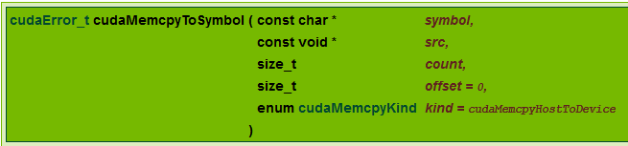
Some common workshop problems
If you have statically allocated device variables:
__device__ float d_array[128];
__constant__ float d_const[16];
Copy to/from them using cudaMemcpy*Symbol:
cudaMemcpyToSymbol(d_const, h_const, sizeof(h_const));
cudaMemcpyFromSymbol(h_array, d_array, sizeof(d_array));
Note: don’t specify a direction – it will interpret this as an offset and probably give an error!

Slide 13
Some common workshop problems
If you have dynamically allocated device variables:
float* d_array;
cudaMalloc(&d_array, 128*sizeof(float));
Copy to/from them using cudaMemcpy:
float h_array[128];
cudaMemcpy(d_array, h_array, sizeof(h_array),
cudaMemcpyHostToDevice);
cudaMemcpy(h_array, d_array, sizeof(h_array),
cudaMemcpyDeviceToHost);

Slide 14
convolution
Hopefully you’ve already seen convolution if you’ve done this week’s workshop.
Mathematical operator – technically we’re looking at discrete convolution.
Usually used in one or two dimensions.

Slide 15
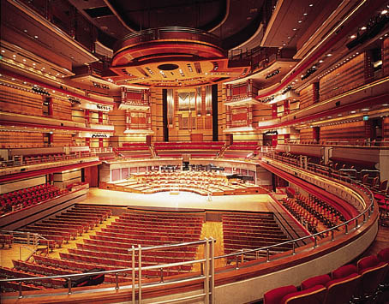
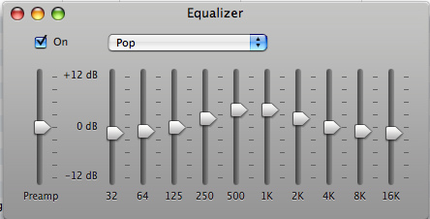
1d Convolution applications
Acoustic modelling: simulate different environments by convolving audio signal with a recording of an “impulse” made in the environment.
Signal processing: e.g. high/low pass filters.
Statistics: e.g. moving average of some data is a 1D convolution.

Slide 16



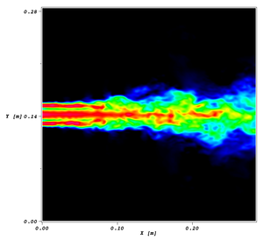

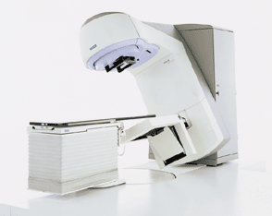
2D+ Convolution applications
Image processing: e.g. blurring, sharpening, edge detection.
Computational fluid dynamics.
Convolutional neural networks.
Radiotherapy planning systems.

Slide 17
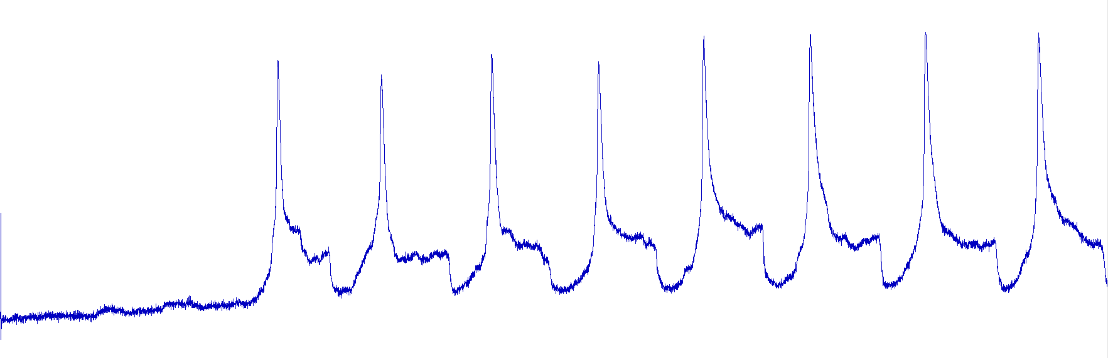
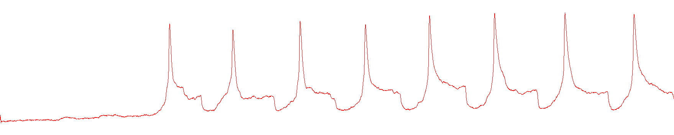
1d convolution example
Simple moving average.
Can use to smooth out noise from signals:
Raw neuron recording
5-point smoothed (twice)
Notes:
Recording of a tadpole neuron by Stella Koutsikou at Bristol University.

Slide 18
Simple moving average
1D array of input data:
0.1
0.2
0.3
0.4
0.3
0.2
0.1
0.2
0.3
0.4
0.3
1D array of output data:
Replace each element with the average of itself and its two neighbours on each side (5-point average).

Slide 19
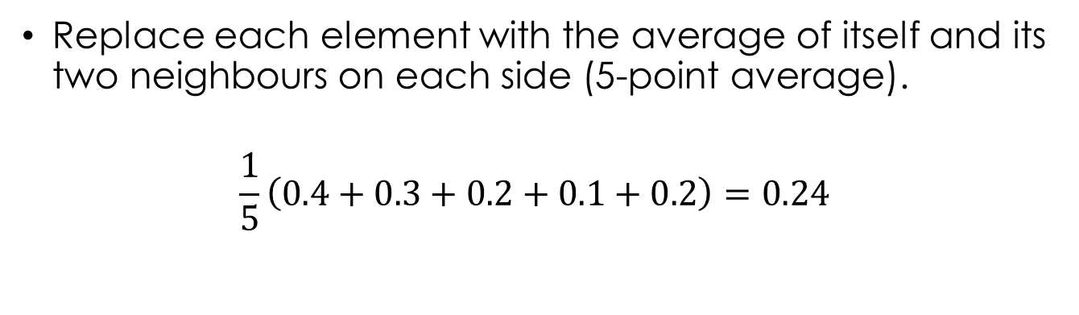
Simple moving average
1D array of input data:
0.1
0.2
0.3
0.4
0.3
0.2
0.1
0.2
0.3
0.4
0.3
1D array of output data:
Replace each element with the average of itself and its two neighbours on each side (5-point average).
$$\frac{1}{5}\left(0.4+0.3+0.2+0.1+0.2\right)=0.24$$

Slide 20
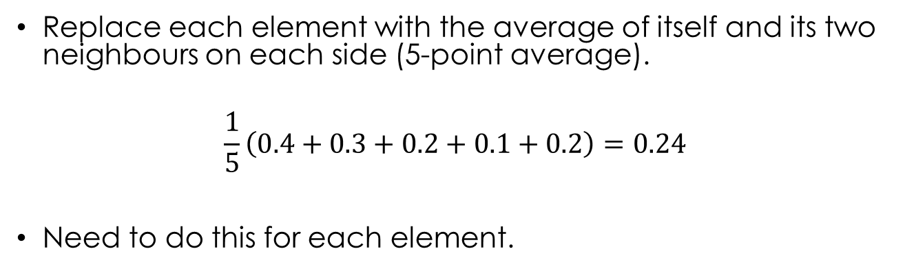
Simple moving average
1D array of input data:
0.1
0.2
0.3
0.4
0.3
0.2
0.1
0.2
0.3
0.4
0.3
1D array of output data:
0.24
Replace each element with the average of itself and its two neighbours on each side (5-point average).
$$\frac{1}{5}\left(0.4+0.3+0.2+0.1+0.2\right)=0.24$$
Need to do this for each element.

Slide 21
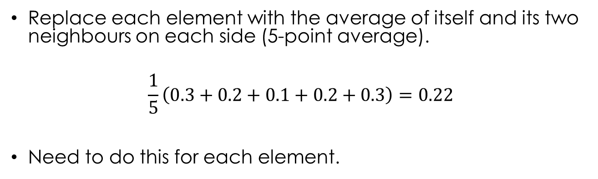
Simple moving average
1D array of input data:
0.1
0.2
0.3
0.4
0.3
0.2
0.1
0.2
0.3
0.4
0.3
1D array of output data:
0.24
0.22
Replace each element with the average of itself and its two neighbours on each side (5-point average).
$$\frac{1}{5}\left(0.3+0.2+0.1+0.2+0.3\right)=0.22$$
Need to do this for each element.

Slide 22
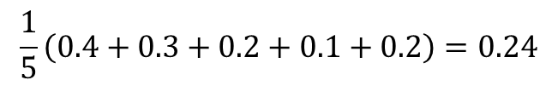
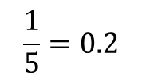
Simple moving average
$$\frac{1}{5}\left(0.4+0.3+0.2+0.1+0.2\right)=0.24$$
This is equivalent to convolving the data with the following mask*:
0.2
0.2
0.2
0.2
0.2
$$\frac{1}{5}=0.2$$
0.1
0.2
0.3
0.4
0.3
0.2
0.1
0.2
0.3
0.4
0.3
0.2
0.2
0.2
0.2
0.2
0.08
0.06
0.04
0.02
0.04
0.24
0.24
* More commonly called a kernel, but we’ll use “mask” to avoid confusion with CUDA kernels.

Slide 23
Simple moving average
$$\frac{1}{5}\left(0.4+0.3+0.2+0.1+0.2\right)=0.24$$
This is equivalent to convolving the data with the following mask:
0.2
0.2
0.2
0.2
0.2
$$\frac{1}{5}=0.2$$
0.1
0.2
0.3
0.4
0.3
0.2
0.1
0.2
0.3
0.4
0.3
0.2
0.2
0.2
0.2
0.2
0.06
0.04
0.02
0.04
0.06
0.22
0.24
0.22

Slide 24
Boundary conditions
How do we calculate the values at the edges?
0.1
0.2
0.3
0.4
0.3
0.2
0.1
0.2
0.3
0.4
0.3
?
?
0.2
0.2
0.2
0.2
0.2
Various options…
Extend the first / last elements:
0.1
0.1
0.1
0.2
0.3
0.4
0.3
0.2
0.1
0.2
0.3
0.4
0.3
0.3
0.3
0.2
0.2
0.2
0.2
0.2

Slide 25
Boundary conditions
How do we calculate the values at the edges?
0.1
0.2
0.3
0.4
0.3
0.2
0.1
0.2
0.3
0.4
0.3
?
?
0.2
0.2
0.2
0.2
0.2
Various options…
Wrap around to the start:
0.1
0.2
0.3
0.4
0.3
0.2
0.1
0.2
0.3
0.4
0.3
0.2
0.2
0.2
0.2
0.2

Slide 26
Boundary conditions
How do we calculate the values at the edges?
0.1
0.2
0.3
0.4
0.3
0.2
0.1
0.2
0.3
0.4
0.3
?
?
0.2
0.2
0.2
0.2
0.2
Various options…
Skip the end elements:
0.1
0.2
0.3
0.4
0.3
0.2
0.1
0.2
0.3
0.4
0.3
Don’t convolve these
Don’t convolve these

Slide 27
Boundary conditions
How do we calculate the values at the edges?
0.1
0.2
0.3
0.4
0.3
0.2
0.1
0.2
0.3
0.4
0.3
?
?
0.2
0.2
0.2
0.2
0.2
Various options…
Skip the end elements:
0.1
0.2
0.3
0.4
0.3
0.2
0.1
0.2
0.3
0.4
0.3
Don’t convolve these
Don’t convolve these
Output is smaller than input.

Slide 28





Other moving average masks
7 point simple moving average:
$$\frac{1}{7}$$
$$\frac{1}{7}$$
$$\frac{1}{7}$$
$$\frac{1}{7}$$
$$\frac{1}{7}$$
$$\frac{1}{7}$$
$$\frac{1}{7}$$
Weighted 5 point moving average:
0.1
0.2
0.4
0.2
0.1
Note: masks are normalised – all elements add up to 1.
3 point trailing average:
$$\frac{1}{3}$$
$$\frac{1}{3}$$
$$\frac{1}{3}$$
0
0
Any 1D discrete convolution (e.g. for audio processing) is defined by its mask, which is just an array of values.

Slide 29
Quick exercise
Convolve this data:
1
2
2
3
22
20
21
21
With this mask:
-1
2
-1
(Extend the boundary elements)
What is this mask doing?
Notes:
The result should be [-1, 1, -1, -18, 21, -3, 1, 0]. The convolution is doing one dimensional edge detection (it’s similar to the 2D mask you used in the workshop) – it outputs a high value where the input data abruptly changes by a large amount.

Slide 30
Parallelising 1D convolution
Strategy: each thread calculates one output value.
Thread 0
0.1
0.1
0.1
0.2
0.3
0.4
0.3
0.2
0.1
0.2
0.3
0.4
0.3
0.3
0.3
0.2
0.2
0.2
0.2
0.2
Thread 1
0.1
0.1
0.1
0.2
0.3
0.4
0.3
0.2
0.1
0.2
0.3
0.4
0.3
0.3
0.3
0.2
0.2
0.2
0.2
0.2
Thread 2
0.1
0.1
0.1
0.2
0.3
0.4
0.3
0.2
0.1
0.2
0.3
0.4
0.3
0.3
0.3
0.2
0.2
0.2
0.2
0.2
Etc…

Slide 31
Code!
// Input and output arrays (N = problem size)
const int N = 1000;
__device__ float d_input[N];
__device__ float d_output[N];
// Convolution mask.
const int M = 5;
__constant__ float d_mask[M] = { 0.2f, 0.2f, 0.2f, 0.2f, 0.2f};
// Adjust an index so that elements on the ends of
// the input repeat infinitely.
__device__ __host__ int getIndexRepeatBounds(int index)
{
if (index < 0) return 0;
if (index >= N) return N - 1;
return index;
}

Slide 32
Code!
// Input and output arrays (N = problem size)
const int N = 1000;
__device__ float d_input[N];
__device__ float d_output[N];
// Convolution mask.
const int M = 5;
__constant__ float d_mask[M] = { 0.2f, 0.2f, 0.2f, 0.2f, 0.2f};
// Adjust an index so that elements on the ends of
// the input repeat infinitely.
__device__ __host__ int getIndexRepeatBounds(int index)
{
if (index < 0) return 0;
if (index >= N) return N - 1;
return index;
}

Slide 33
Code!
// Input and output arrays (N = problem size)
const int N = 1000;
__device__ float d_input[N];
__device__ float d_output[N];
// Convolution mask.
const int M = 5;
__constant__ float d_mask[M] = { 0.2f, 0.2f, 0.2f, 0.2f, 0.2f};
// Adjust an index so that elements on the ends of
// the input repeat infinitely.
__device__ __host__ int getIndexRepeatBounds(int index)
{
if (index < 0) return 0;
if (index >= N) return N - 1;
return index;
}

Slide 34
Code!
// Simple 1D convolution kernel.
__global__ void convolveKernel()
{
int globalId = blockIdx.x*blockDim.x + threadIdx.x;
if (globalId < N) {
float conv = 0.0f;
for (int i = 0; i < M; i++) {
int inputIndex = globalId - M / 2 + i;
conv += d_input[getIndexRepeatBounds(inputIndex)]
* d_mask[i];
}
d_output[globalId] = conv;
}
}

Slide 35
Code!
// Simple 1D convolution kernel.
__global__ void convolveKernel()
{
int globalId = blockIdx.x*blockDim.x + threadIdx.x;
if (globalId < N) {
float conv = 0.0f;
for (int i = 0; i < M; i++) {
int inputIndex = globalId - M / 2 + i;
conv += d_input[getIndexRepeatBounds(inputIndex)]
* d_mask[i];
}
d_output[globalId] = conv;
}
}

Slide 36
Code!
// Simple 1D convolution kernel.
__global__ void convolveKernel()
{
int globalId = blockIdx.x*blockDim.x + threadIdx.x;
if (globalId < N) {
float conv = 0.0f;
for (int i = 0; i < M; i++) {
int inputIndex = globalId - M / 2 + i;
conv += d_input[getIndexRepeatBounds(inputIndex)]
* d_mask[i];
}
d_output[globalId] = conv;
}
}

Slide 37
Code!
// Simple 1D convolution kernel.
__global__ void convolveKernel()
{
int globalId = blockIdx.x*blockDim.x + threadIdx.x;
if (globalId < N) {
float conv = 0.0f;
for (int i = 0; i < M; i++) {
int inputIndex = globalId - M / 2 + i;
conv += d_input[getIndexRepeatBounds(inputIndex)]
* d_mask[i];
}
d_output[globalId] = conv;
}
}

Slide 38
using shared memory
Assume the threads are organised into blocks of four.
0.1
0.2
0.3
0.4
0.3
0.2
0.1
0.2
0.3
0.4
0.3
Block 0 convolves these elements.
Block 1 convolves these elements.
Block 2 convolves these elements.
How many times is each element in global memory accessed by the threads in block 1?
Mask size (M) = 5
|
|
|
|
|
0.1
0.2
0.3
0.4
0.3
0.2
0.1
0.2
0.3
0.4
0.3

Slide 39
using shared memory
Assume the threads are organised into blocks of four.
0.1
0.2
0.3
0.4
0.3
0.2
0.1
0.2
0.3
0.4
0.3
Block 0 convolves these elements.
Block 1 convolves these elements.
Block 2 convolves these elements.
How many times is each element in global memory accessed by the threads in block 1?
Mask size (M) = 5
|
||
||
||
||
|
0.1
0.2
0.3
0.4
0.3
0.2
0.1
0.2
0.3
0.4
0.3

Slide 40
using shared memory
Assume the threads are organised into blocks of four.
0.1
0.2
0.3
0.4
0.3
0.2
0.1
0.2
0.3
0.4
0.3
Block 0 convolves these elements.
Block 1 convolves these elements.
Block 2 convolves these elements.
How many times is each element in global memory accessed by the threads in block 1?
Mask size (M) = 5
|
||
|||
|||
|||
||
|
0.1
0.2
0.3
0.4
0.3
0.2
0.1
0.2
0.3
0.4
0.3

Slide 41
using shared memory
Assume the threads are organised into blocks of four.
0.1
0.2
0.3
0.4
0.3
0.2
0.1
0.2
0.3
0.4
0.3
Block 0 convolves these elements.
Block 1 convolves these elements.
Block 2 convolves these elements.
How many times is each element in global memory accessed by the threads in block 1?
Mask size (M) = 5
|
||
|||
||||
||||
|||
||
|
0.1
0.2
0.3
0.4
0.3
0.2
0.1
0.2
0.3
0.4
0.3

Slide 42
using shared memory
|
||
|||
||||
||||
|||
||
|
0.1
0.2
0.3
0.4
0.3
0.2
0.1
0.2
0.3
0.4
0.3
20 global memory accesses across the block…
… but to only 8 different memory addresses.
If we just load each element that the block needs into shared memory once, would only need 8 global memory accesses → reduction of 60%.
(Caching will help somewhat anyway, but should still get an improvement using shared memory)

Slide 43
Using shared memory
What is the improvement in general?
In the simple algorithm, how many global memory accesses does each block do?
Every thread needs to access one element for each value in the mask, so M accesses per thread.
If there are D_{B} threads in a block, then total global memory accesses per block is M*D_{B}.

Slide 44
Using shared memory
How many global memory accesses do we need if we use shared memory (assume it’s big enough)?
Need the value at to each thread’s position:
(D_{B} of these)
0.1
0.2
0.3
0.4
0.3
0.2
0.1
0.2
0.3
0.4
0.3
And also some neighbouring values:
(M-1 of these)
0.1
0.2
0.3
0.4
0.3
0.2
0.1
0.2
0.3
0.4
0.3
The neighbour values are called halo / apron elements.
So total number of accesses is D_{B}+M-1

Slide 45

Using shared memory
So for the simple case we have M*D_{B} global memory accesses.
And in the shared memory case we have D_{B}+M-1 global memory accesses.
Assume 32 threads per block (D_{B}=32). If we increase the mask size (M) by 2, how many more global memory accesses for each method?
Simple method: 2*32 = 64
Shared memory method: 2
Improvement: $\frac{D_{B}+M−1}{MD_{B}}$

Slide 46
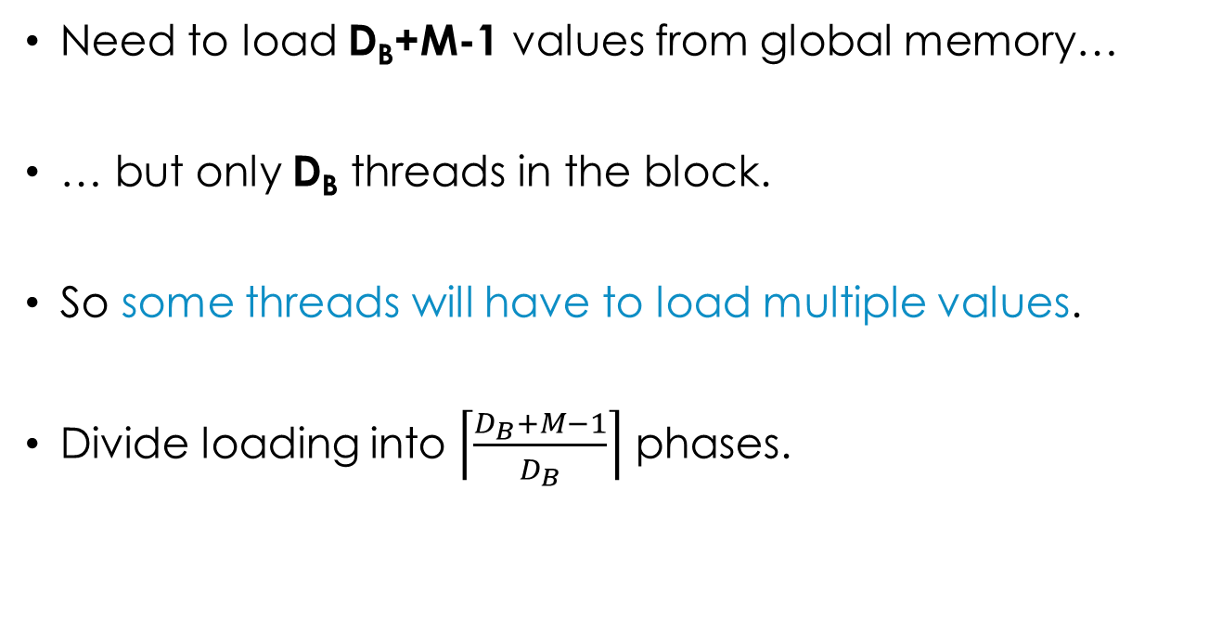
implementation
Need to load D_{B}+M-1 values from global memory…
… but only D_{B} threads in the block.
So some threads will have to load multiple values.
Divide loading into $\left\lceil \frac{D_{B}+M−1}{D_{B}}\right\rceil$ phases.
Ceiling function (round up)

Slide 47
implementation
The first element to be convolved by block i is i*D_{B}.
E.g. for block 1 (2nd block), D_{B}=4:
Element 1*4
0.1
0.2
0.3
0.4
0.3
0.2
0.1
0.2
0.3
0.4
0.3
The first element to be loaded by block i is i*D_{B}-M/2.
E.g. for block 1, D_{B}=4, M=5:
Element 1*4-5/2
Integer division, so if M=5, M/2=2
0.1
0.2
0.3
0.4
0.3
0.2
0.1
0.2
0.3
0.4
0.3

Slide 48
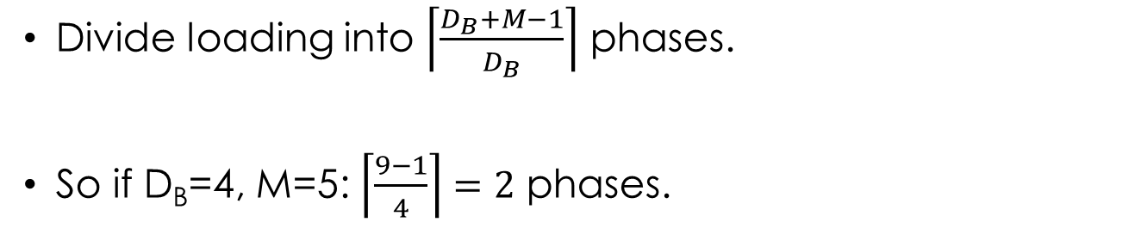
implementation
Divide loading into $\left\lceil \frac{D_{B}+M−1}{D_{B}}\right\rceil$ phases.
So if D_{B}=4, M=5: $\left\lceil \frac{9−1}{4}\right\rceil =2$ phases.
Phase 0
0.1
0.2
0.3
0.4
0.3
0.2
0.1
0.2
0.3
0.4
0.3
Thread 0
Thread 1
Thread 2
Thread 3
Shared memory for block 1

Slide 49
implementation
Divide loading into $\left\lceil \frac{D_{B}+M−1}{D_{B}}\right\rceil$ phases.
So if D_{B}=4, M=5: $\left\lceil \frac{9−1}{4}\right\rceil =2$ phases.
Phase 0
0.1
0.2
0.3
0.4
0.3
0.2
0.1
0.2
0.3
0.4
0.3
Thread 0
Thread 1
Thread 2
Thread 3
Shared memory for block 1
0.3
0.4
0.3
0.2

Slide 50
implementation
Divide loading into $\left\lceil \frac{D_{B}+M−1}{D_{B}}\right\rceil$ phases.
So if D_{B}=4, M=5: $\left\lceil \frac{9−1}{4}\right\rceil =2$ phases.
Phase 1
0.1
0.2
0.3
0.4
0.3
0.2
0.1
0.2
0.3
0.4
0.3
Thread 0
Thread 1
Thread 2
Thread 3
Shared memory for block 1
0.3
0.4
0.3
0.2

Slide 51
implementation
Divide loading into $\left\lceil \frac{D_{B}+M−1}{D_{B}}\right\rceil$ phases.
So if D_{B}=4, M=5: $\left\lceil \frac{9−1}{4}\right\rceil =2$ phases.
Phase 1
0.1
0.2
0.3
0.4
0.3
0.2
0.1
0.2
0.3
0.4
0.3
Thread 0
Thread 1
Thread 2
Thread 3
Shared memory for block 1
0.3
0.4
0.3
0.2
0.1
0.2
0.3
0.4

Slide 52
Code!
// Number of threads per block.
const int Db = 4;
// Total number of elements to load into shared memory.
const int sharedBufSize = Db + M - 1;
// Shared memory.
__shared__ float d_shared[sharedBufSize];

Slide 53
Code!
// Number of threads per block.
const int Db = 4;
// Total number of elements to load into shared memory.
const int sharedBufSize = Db + M - 1;
// Shared memory.
__shared__ float d_shared[sharedBufSize];
Load one element for each thread in the block, plus M-1 halo elements at each end.
0.1
0.2
0.3
0.4
0.3
0.2
0.1
0.2
0.3
0.4
0.3
Db
sharedBufSize

Slide 54
Code!
// Number of threads per block.
const int Db = 4;
// Total number of elements to load into shared memory.
const int sharedBufSize = Db + M - 1;
// Shared memory.
__shared__ float d_shared[sharedBufSize];
Kernel Code
__global__ void convolveKernelShared()
{
// Load elements into shared memory (in phases)
int numPhases = (sharedBufSize) / Db;
if (((sharedBufSize) % Db) != 0) numPhases++;
Round up the number of phases.

Slide 55
Code!
// Number of threads per block.
const int Db = 4;
// Total number of elements to load into shared memory.
const int sharedBufSize = Db + M - 1;
// Shared memory.
__shared__ float d_shared[sharedBufSize];
int firstHaloIdx = blockIdx.x * Db - M / 2;
for (int p = 0; p < numPhases; p++) {
int offset = p*Db + threadIdx.x;
if (offset < sharedBufSize) {
d_shared[offset] =
d_input[getIndexRepeatBounds(firstHaloIdx + offset)];
}
}
__syncthreads();

Slide 56
Code!
// Number of threads per block.
const int Db = 4;
// Total number of elements to load into shared memory.
const int sharedBufSize = Db + M - 1;
// Shared memory.
__shared__ float d_shared[sharedBufSize];
int firstHaloIdx = blockIdx.x * Db - M / 2;
for (int p = 0; p < numPhases; p++) {
int offset = p*Db + threadIdx.x;
if (offset < sharedBufSize) {
d_shared[offset] =
d_input[getIndexRepeatBounds(firstHaloIdx + offset)];
}
}
__syncthreads();
0.1
0.2
0.3
0.4
0.3
0.2
0.1
0.2
0.3
0.4
0.3

Slide 57
Code!
// Number of threads per block.
const int Db = 4;
// Total number of elements to load into shared memory.
const int sharedBufSize = Db + M - 1;
// Shared memory.
__shared__ float d_shared[sharedBufSize];
int firstHaloIdx = blockIdx.x * Db - M / 2;
for (int p = 0; p < numPhases; p++) {
int offset = p*Db + threadIdx.x;
if (offset < sharedBufSize) {
d_shared[offset] =
d_input[getIndexRepeatBounds(firstHaloIdx + offset)];
}
}
__syncthreads();
0.1
0.2
0.3
0.4
0.3
0.2
0.1
0.2
0.3
0.4
0.3
E.g. offset for second thread (index 1) in phase 0

Slide 58
Code!
// Number of threads per block.
const int Db = 4;
// Total number of elements to load into shared memory.
const int sharedBufSize = Db + M - 1;
// Shared memory.
__shared__ float d_shared[sharedBufSize];
int firstHaloIdx = blockIdx.x * Db - M / 2;
for (int p = 0; p < numPhases; p++) {
int offset = p*Db + threadIdx.x;
if (offset < sharedBufSize) {
d_shared[offset] =
d_input[getIndexRepeatBounds(firstHaloIdx + offset)];
}
}
__syncthreads();
0.1
0.2
0.3
0.4
0.3
0.2
0.1
0.2
0.3
0.4
0.3
E.g. offset for second thread (index 1) in phase 1

Slide 59
Code!
// Number of threads per block.
const int Db = 4;
// Total number of elements to load into shared memory.
const int sharedBufSize = Db + M - 1;
// Shared memory.
__shared__ float d_shared[sharedBufSize];
int globalId = blockIdx.x*blockDim.x + threadIdx.x;
if (globalId < N) {
float conv = 0.0f;
for (int i = 0; i < M; i++) {
conv += d_shared[threadIdx.x + i] * d_mask[i];
}
d_output[globalId] = conv;
}
}

Slide 60
Results
N=10,000; vary mask size (M)
Apply convolution 1,000 times (to get bigger numbers).
For small mask sizes the simple kernel is faster!
More complicated shared memory kernel has some extra overheads, which outweigh the benefits with small M.

Slide 61
Results
N=10,000; vary mask size (M)
Apply convolution 1,000 times (to get bigger numbers).
For larger masks, shared memory version is much faster.
E.g. M=51, 365ms vs 258ms (30% faster)

Slide 62
CGMa ratio
How many computations does each block do?
0.1
0.2
0.3
0.4
0.3
0.2
0.1
0.2
0.3
0.4
0.3
0.2
0.2
0.2
0.2
0.2
0.08
0.06
0.04
0.02
0.04
0.24
Notes:
Note that we’re only actually interested in how many useful computations the kernel does – i.e. ones that are directly part of the convolution. We’re ignoring the other operations (e.g. calculating indexes and offsets).

Slide 63
CGMa ratio
How many computations does each block do?
0.1
0.2
0.3
0.4
0.3
0.2
0.1
0.2
0.3
0.4
0.3
0.2
0.2
0.2
0.2
0.2
0.08
0.06
0.04
0.02
0.04
0.24
Each thread does M multiplications…

Slide 64
CGMa ratio
How many computations does each block do?
0.1
0.2
0.3
0.4
0.3
0.2
0.1
0.2
0.3
0.4
0.3
0.2
0.2
0.2
0.2
0.2
0.08
0.06
0.04
0.02
0.04
0.24
Each thread does M multiplications…
… and (M-1) additions.
And there are D_{B} threads in a block.
So a block does D_{B} * (M + (M-1)) computations.
= D_{B} * (2M – 1)

Slide 65
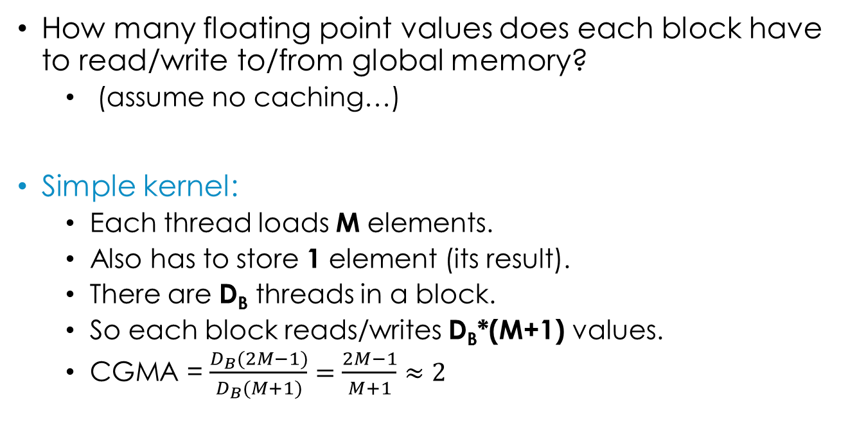
CGMA ratio
How many floating point values does each block have to read/write to/from global memory?
(assume no caching…)
Simple kernel:
Each thread loads M elements.
Also has to store 1 element (its result).
There are D_{B} threads in a block.
So each block reads/writes D_{B}*(M+1) values.
CGMA = $\frac{D_{B}(2M−1)}{D_{B}(M+1)}=\frac{2M−1}{M+1}≈2$
Rubbish!
Notes:
For larger values of M the -1 and +1 don’t really have much effect, so we can ignore them. This leaves 2M/M, which is 2.

Slide 66
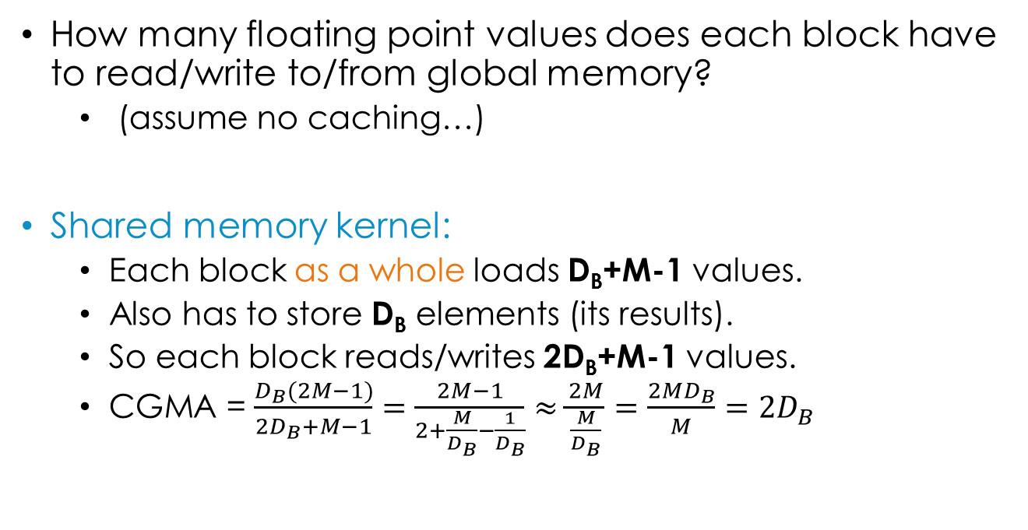
CGMA ratio
How many floating point values does each block have to read/write to/from global memory?
(assume no caching…)
Shared memory kernel:
Each block as a whole loads D_{B}+M-1 values.
Also has to store D_{B} elements (its results).
So each block reads/writes 2D_{B}+M-1 values.
CGMA = $\frac{D_{B}(2M−1)}{2D_{B}+M−1}=\frac{2M−1}{2+\frac{M}{D_{B}}−\frac{1}{D_{B}}}≈\frac{2M}{\frac{M}{D_{B}}}=\frac{2MD_{B}}{M}=2D_{B}$
Notes:
For larger values of M the -1 and +1 don’t really have much effect, so we can ignore them.

Slide 67
CGMA ratio
Threads per block (D_{B})=27
As the mask size increases, CGMA reaches its theoretical limit of 2*D_{B}=54 for the shared memory kernel.
Whereas in the simple kernel its limit is 2.

Slide 68
CGMA ratio
Threads per block (D_{B})=27
With modern GPUs aim for CGMA > 30.
On GTX480 memory bandwidth is 177GB/s = 44k floats / s.
CGMA=2 → max. utilized processing power is 44*2=88 GFLOPS
Card capacity is 1,345 GFLOPS → memory limits us!

Slide 69
CGMA ratio
Threads per block (D_{B})=27
If CGMA is 54, max. utilized processing power is 44*54=2,376 GFLOPS
Card capacity is 1,345 GFLOPS → memory isn’t the limitation.

Slide 70
occupancy
Recall that occupancy is how many threads can be resident in one streaming multiprocessor at once.
Want to maximize this!
The available shared memory can be a limiting factor.

Slide 71
occupancy
In CC 3.0, there can be up to 16 blocks per multiprocessor, but they share 48KB of shared memory.
This means to use the full 16 blocks, each block is limited to 48/16 = 3KB of shared memory.
In the shared memory kernel, each block loads D_{B}+M-1 values into shared memory → (D_{B}+M-1)*4 bytes.

Slide 72
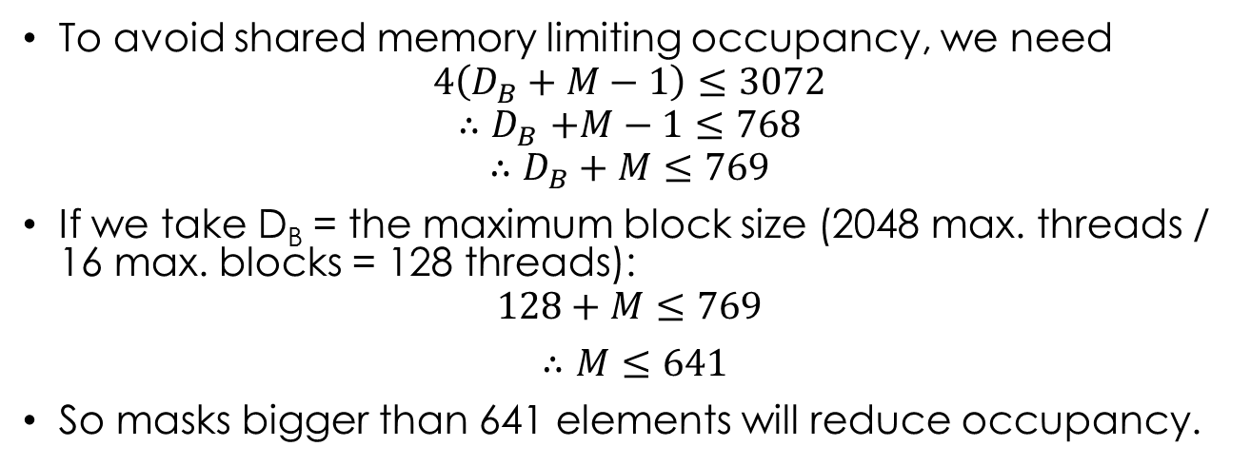
occupancy
To avoid shared memory limiting occupancy, we need
$$4\left(D_{B}+M−1\right)≤3072$$
$${∴D}_{B}+M−1≤768$$
$$∴D_{B}+M≤769$$
If we take D_{B} = the maximum block size (2048 max. threads / 16 max. blocks = 128 threads):
$$128+M≤769$$
$∴M≤641$
So masks bigger than 641 elements will reduce occupancy.
Notes:
3072 = 3*1024 = 3KB

Slide 73
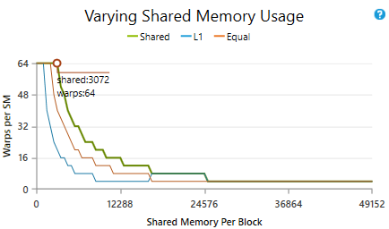
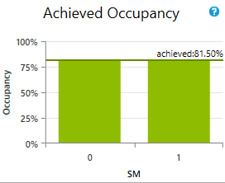
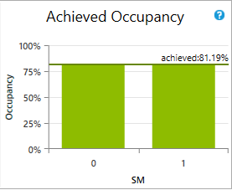
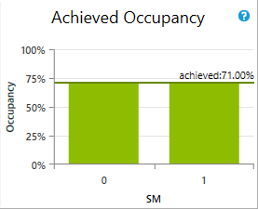
occupancy
M=641
Is this true in practice?
Yes!
From my laptop (CC3.0):
M=640
M=641
M=642
Notes:
The three lines in the upper-right diagram are for the different possible configurations of shared memory / L1 cache. You can choose 48K of shared memory and 16K of L1, or 48K of L1 and 16K of shared, or 32KB of each (“Equal”).

Slide 74
Questions
You can configure CUDA so that each SM has 16KB of shared memory instead of 48KB. On a CC3.0 card, at what mask size would shared memory limit occupancy if there was only 16KB available?
On a CC2.x card, at what mask size would shared memory limit occupancy if there was 48KB available?
Each block loads D_{B}+M-1 values into shared memory → (D_{B}+M-1)*4 bytes.
Notes:
In the configuration where there is only 16KB of shared memory, L1 cache is increased to 48KB.

Slide 75
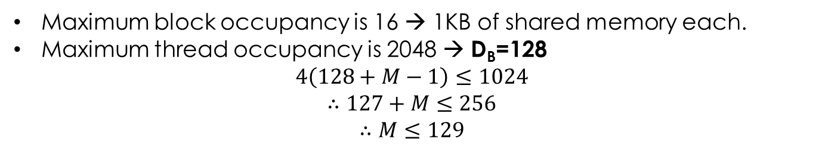
Questions
You can configure CUDA so that each SM has 16KB of shared memory instead of 48KB. On a CC3.0 card, at what mask size would shared memory limit occupancy if there was only 16KB available?
Each block loads D_{B}+M-1 values into shared memory → (D_{B}+M-1)*4 bytes.
Maximum block occupancy is 16 → 1KB of shared memory each.
Maximum thread occupancy is 2048 → D_{B}=128
$$4\left(128+M−1\right)≤1024$$
$$∴127+M≤256$$
$$∴M≤129$$
Notes:
In the configuration where there is only 16KB of shared memory, L1 cache is increased to 48KB.

Slide 76
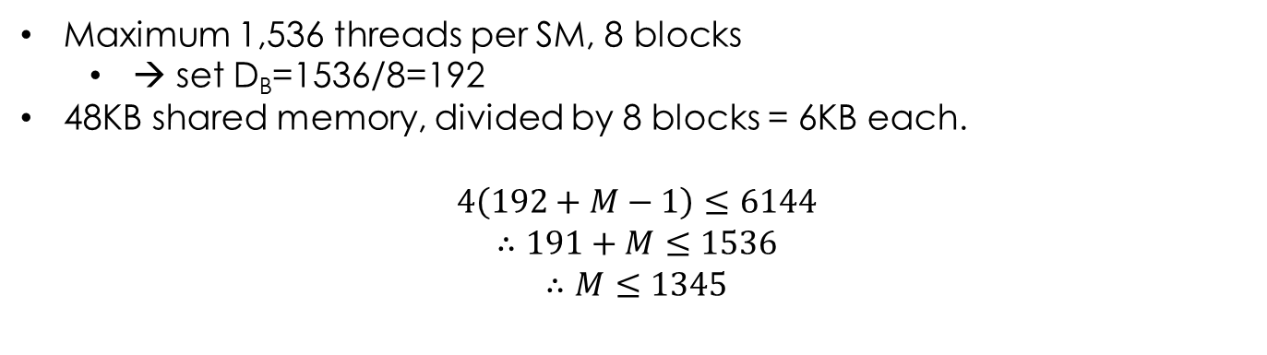
Questions
On a CC2.x card, at what mask size would shared memory limit occupancy if there was 48KB available?
Each block loads D_{B}+M-1 values into shared memory → (D_{B}+M-1)*4 bytes.
Maximum 1,536 threads per SM, 8 blocks
→ set D_{B}=1536/8=192
48KB shared memory, divided by 8 blocks = 6KB each.
$$4\left(192+M−1\right)≤6144$$
$$∴191+M≤1536$$
$$∴M≤1345$$
CC2 has the same amount of shared memory but fewer maximum resident blocks → each block can use more shared memory.

Slide 77
2d Convolution
Basically the same, except now you have 2D data, a 2D mask, and a 2D grid of threads.
0.89 | 0.67 | 0.61 | 0.17
0.68 | 0.70 | 0.11 | 0.56
0.19 | 0.91 | 0.76 | 0.18
0.31 | 0.05 | 0.15 | 0.77
0.89*0 | 0.67*0 | 0.61*0 | 0.17*0
0.68*0 | 0.70*1 | 0.11*4 | 0.56*7
0.19*0 | 0.91*2 | 0.76*5 | 0.18*8
0.31*0 | 0.05*3 | 0.15*6 | 0.77*9
1 | 4 | 7
2 | 5 | 8
3 | 6 | 9
Data (convolve shaded element)
Kernel
Add coloured values together to get new value for the red element.

Slide 78
2d convolution
Can handle boundaries by repeating elements:
0.89 | 0.89 | 0.67 | 0.61 | 0.17 | 0.17
0.89 | 0.89 | 0.67 | 0.61 | 0.17 | 0.17
0.68 | 0.68 | 0.70 | 0.11 | 0.56 | 0.56
0.19 | 0.19 | 0.91 | 0.76 | 0.18 | 0.18
0.31 | 0.31 | 0.05 | 0.15 | 0.77 | 0.77
0.31 | 0.31 | 0.05 | 0.15 | 0.77 | 0.77
Or the other techniques (wrapping, skipping).

Slide 79
Shared memory 2d convolution
Assume four D_{B}xD_{B} blocks:
0.89 | 0.89 | 0.67 | 0.61 | 0.17 | 0.17
0.89 | 0.89 | 0.67 | 0.61 | 0.17 | 0.17
0.68 | 0.68 | 0.70 | 0.11 | 0.56 | 0.56
0.19 | 0.19 | 0.91 | 0.76 | 0.18 | 0.18
0.31 | 0.31 | 0.05 | 0.15 | 0.77 | 0.77
0.31 | 0.31 | 0.05 | 0.15 | 0.77 | 0.77
D_{B}=2
Each block has to load (D_{B}+1)² elements.

Slide 80
Shared memory 2d convolution
Assume four D_{B}xD_{B} blocks:
0.89 | 0.89 | 0.67 | 0.61 | 0.17 | 0.17
0.89 | 0.89 | 0.67 | 0.61 | 0.17 | 0.17
0.68 | 0.68 | 0.70 | 0.11 | 0.56 | 0.56
0.19 | 0.19 | 0.91 | 0.76 | 0.18 | 0.18
0.31 | 0.31 | 0.05 | 0.15 | 0.77 | 0.77
0.31 | 0.31 | 0.05 | 0.15 | 0.77 | 0.77
D_{B}=2
Each block has to load (D_{B}+M-1)² elements.
Divide loading into phases.

Slide 81
Shared memory 2d convolution
Assume four D_{B}xD_{B} blocks:
Phase 0
0.89 | 0.89 | 0.67 | 0.61 | 0.17 | 0.17
0.89 | 0.89 | 0.67 | 0.61 | 0.17 | 0.17
0.68 | 0.68 | 0.70 | 0.11 | 0.56 | 0.56
0.19 | 0.19 | 0.91 | 0.76 | 0.18 | 0.18
0.31 | 0.31 | 0.05 | 0.15 | 0.77 | 0.77
0.31 | 0.31 | 0.05 | 0.15 | 0.77 | 0.77
Phase 1
Phase 2
D_{B}=2
Phase 3
Each block has to load (D_{B}+M-1)² elements.
Divide loading into phases.

Slide 82
summary
Convolution is a very important mathematical operation with many applications.
On the GPU convolution can be sped up greatly (esp. when M is large) by using shared memory.
Seen a couple of examples of calculating compute to global memory access ratios: aim for > 30.
Beware: shared memory can limit occupancy.

